Slide 1
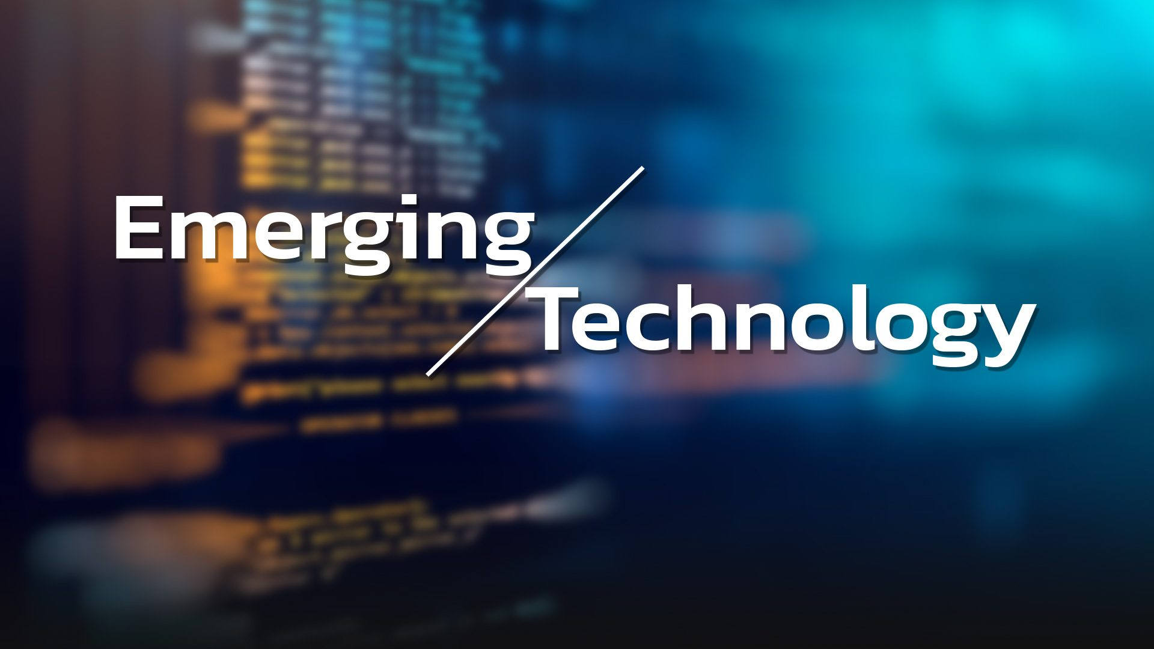
GROUP 1

Slide 2
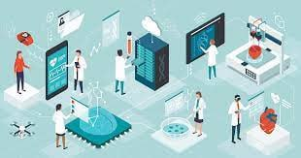
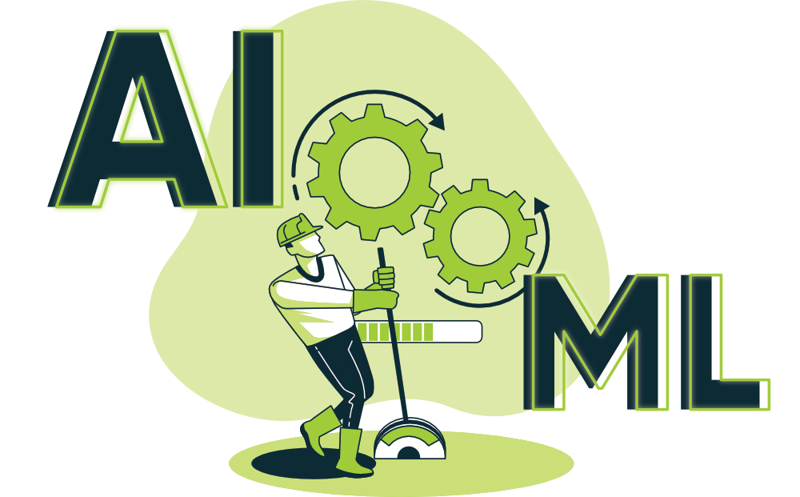
1. Artificial Intelligence (AI) and Machine Learning (ML)
Artificial intelligence is the intelligence of machines or software, as opposed to the intelligence of human beings or animals

Slide 3
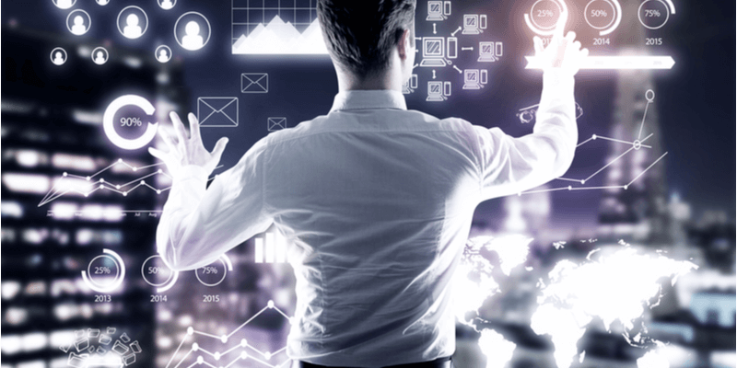
2. Datafication
Datafication is a technological trend turning many aspects of our life into data which is subsequently transferred into information realised as a new form of value.

Slide 4
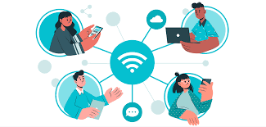
3. Internet of Things (IoT)
The internet of things, or IoT, is a system of interrelated computing devices, mechanical and digital machines, objects, animals or people that are provided with unique identifiers and the ability to transfer data over a network without requiring human-to-human or human-to-computer interaction.

Slide 5

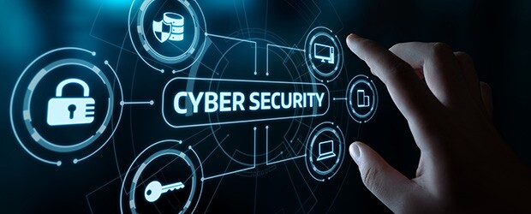
4. Cybersecurity
Cybersecurity is the practice of protecting systems, networks, and programs from digital attacks.

